Slide 1
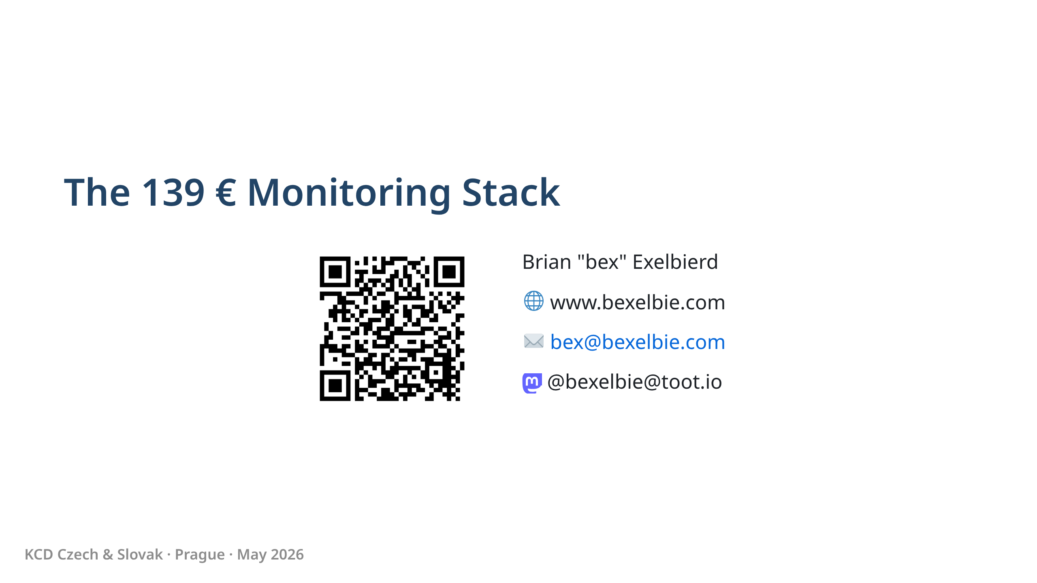
Notes:
- Hi, I'm bex. I work at Microsoft on Linux things, but this talk has nothing to do with that.
- 139 euros is not a typo. That's my entire monitoring budget. It's really less than that and you'll see why.
- I run a significant load bearing piece of internet infrastructure ...

Slide 2
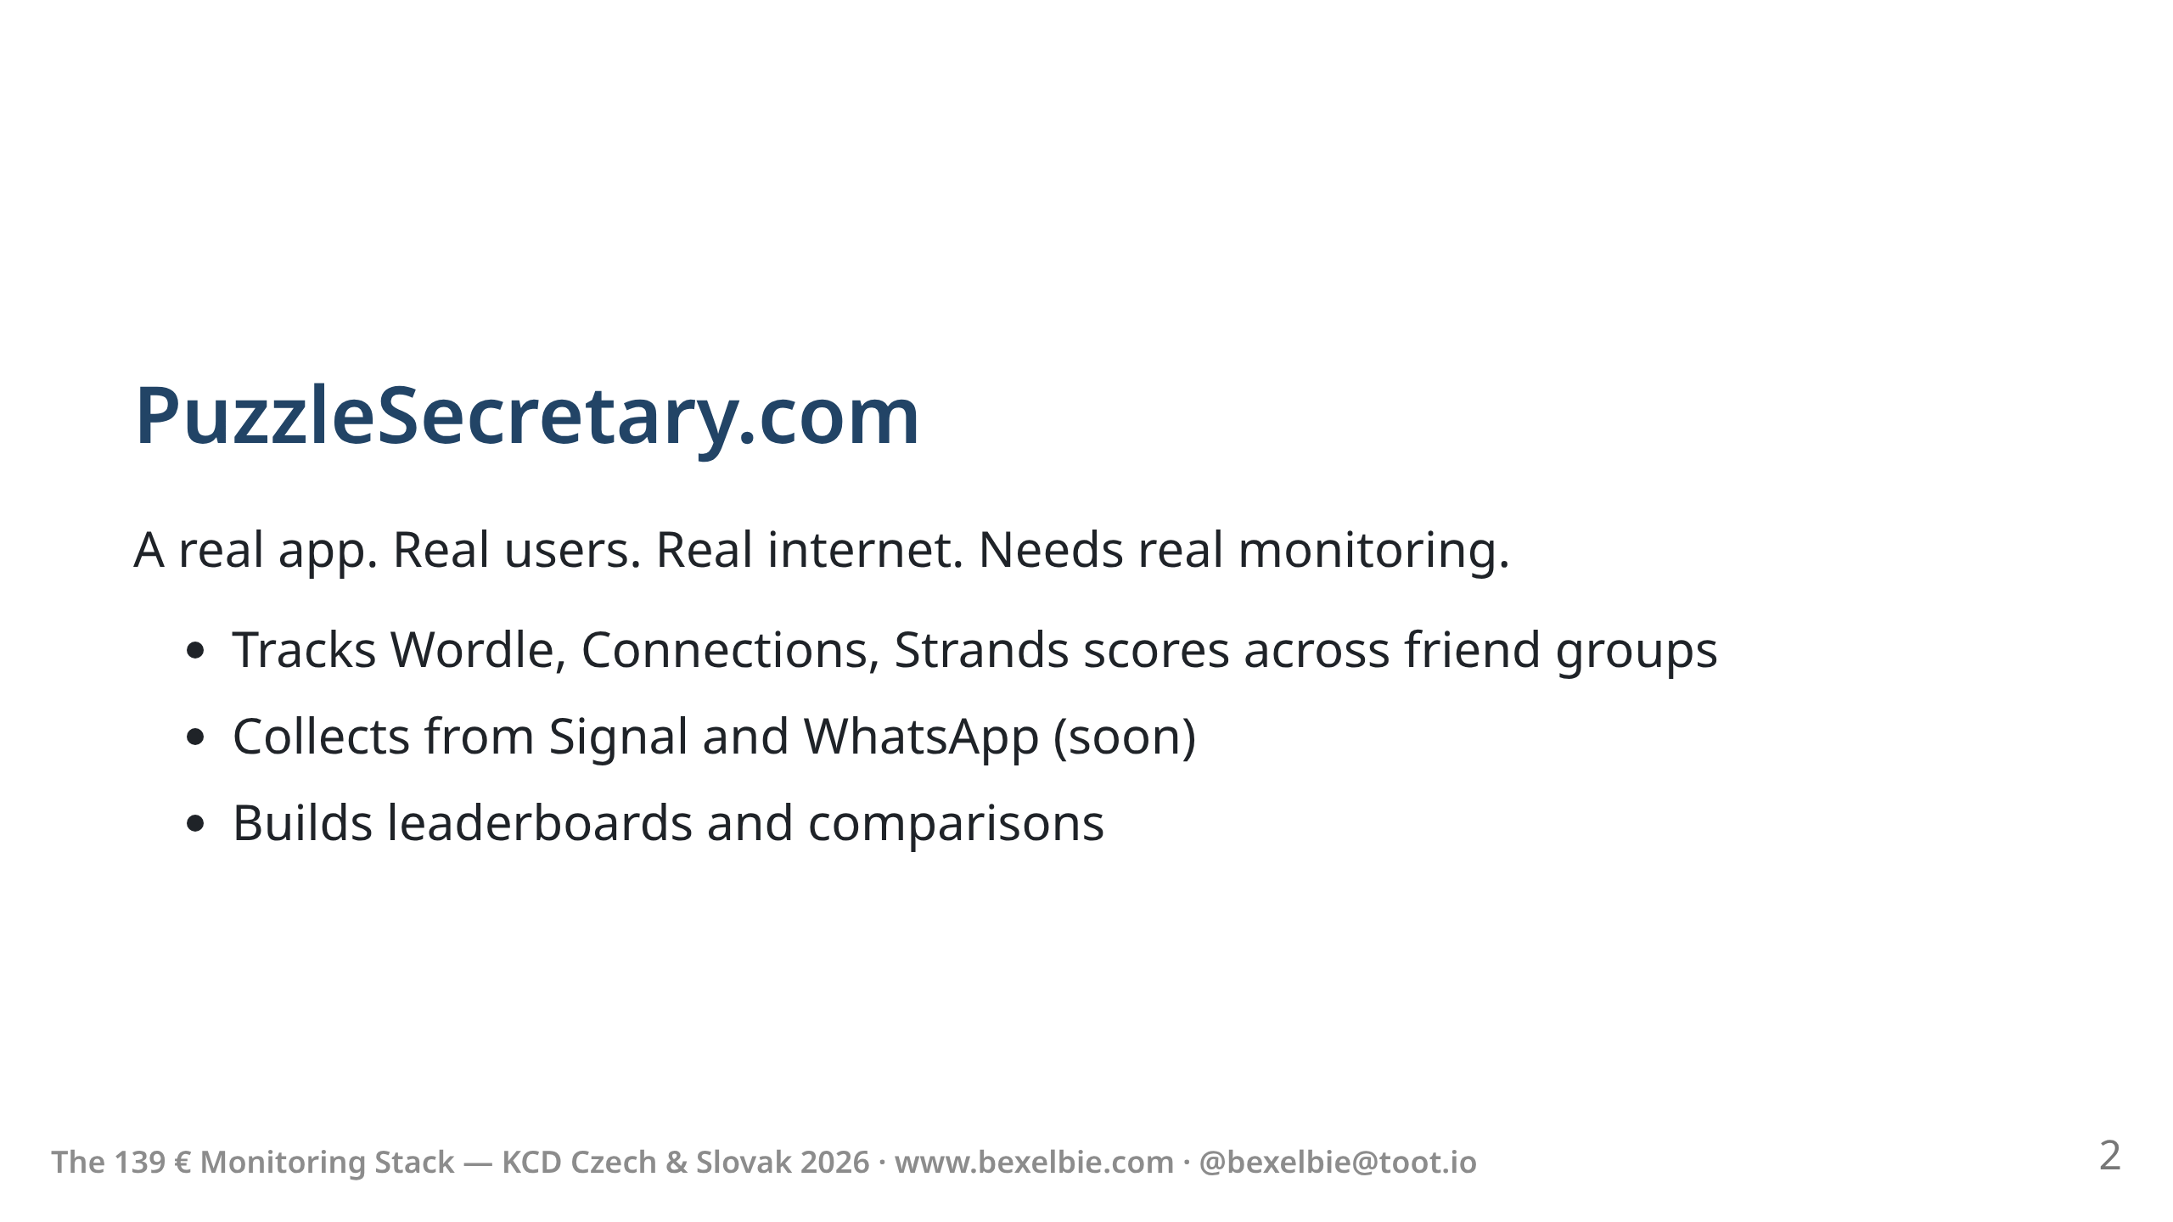
Notes:
- I am of course talking about puzzlesecretary.com
- This is a production web service. People use it every day.
- In full disclosure, runs on one Azure VM. No cluster. No fleet. Just one server, bravely existing without a service mesh.
- But it still needs monitoring.

Slide 3
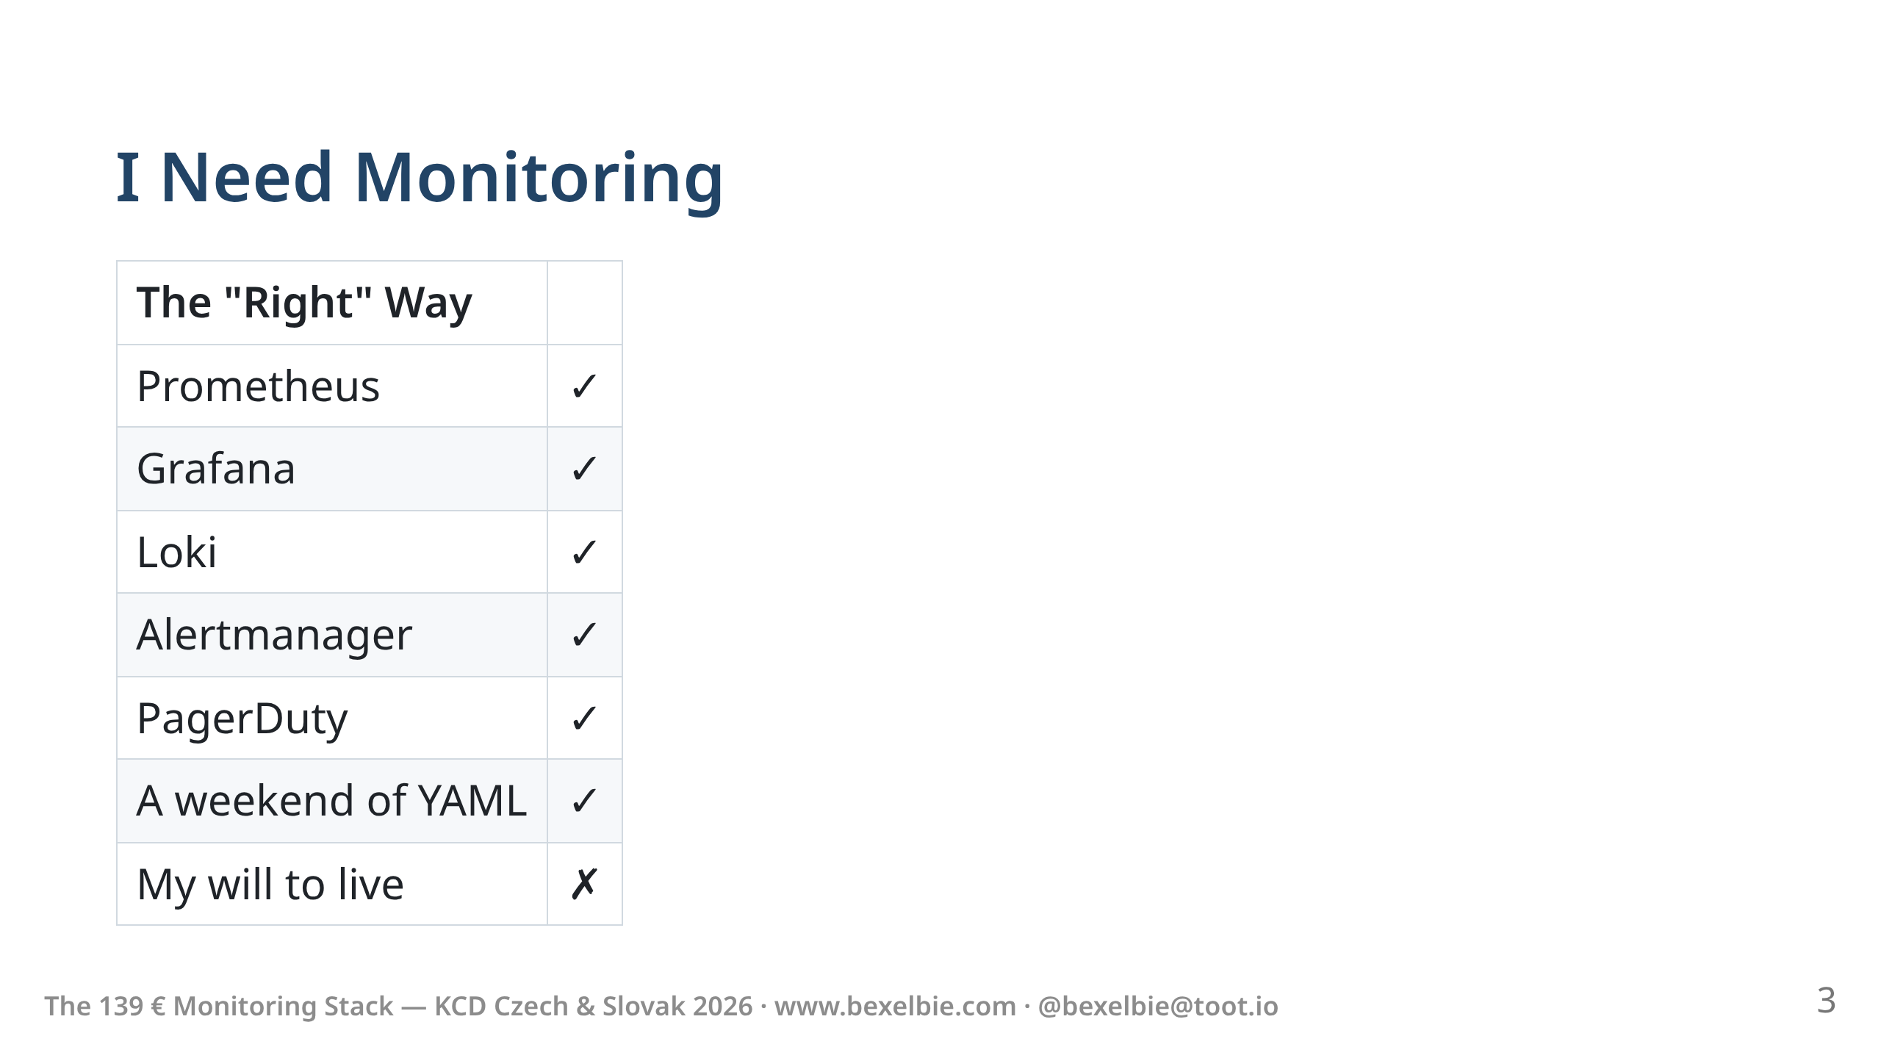
Notes:
- You all know the proper way. This is your day job.
- Metrics, logs, traces, dashboards, alerts, a small galaxy of YAML.
- Step 1: install and wire up 17 things. Step 2: your soul leaves your body.
- I love all of you for building this. But .. do not want.
- My side project is playing games and improving puzzlesecretary
- NOT monitoring puzzle secretary

Slide 4
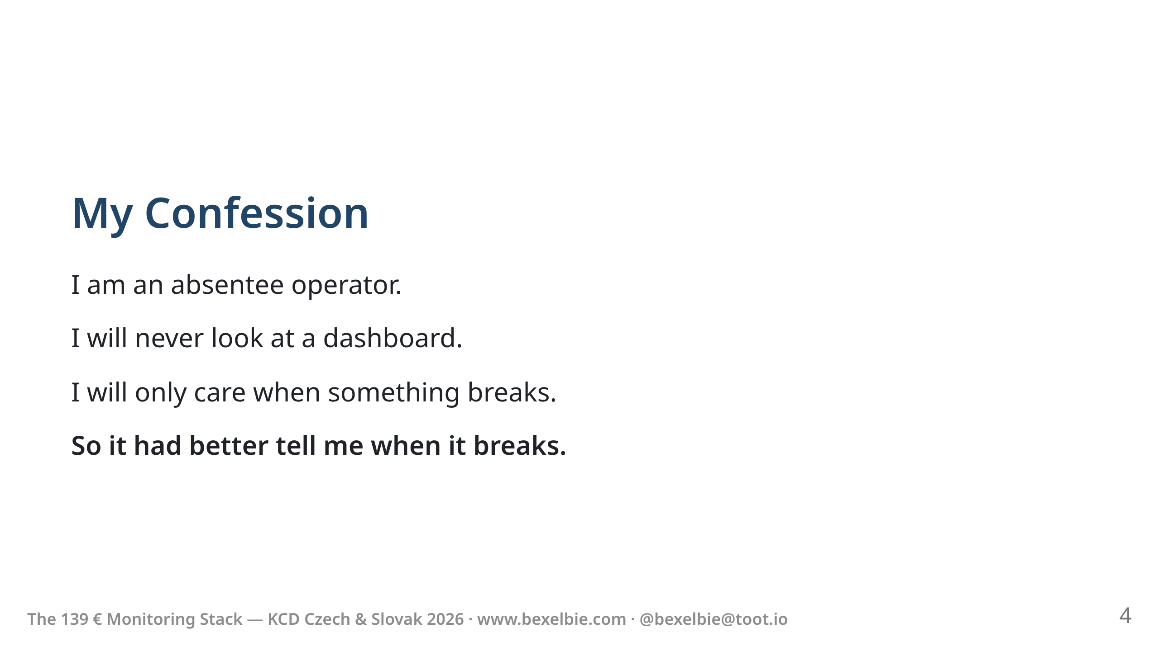
Notes:
- I have some more confessions to make.
- I'm not going to get up every morning and check traffic graphs.
- I'm not keeping a monitor in the corner with pretty lines.
- I need a system that yells at me. Not one that waits politely to be consulted.

Slide 5
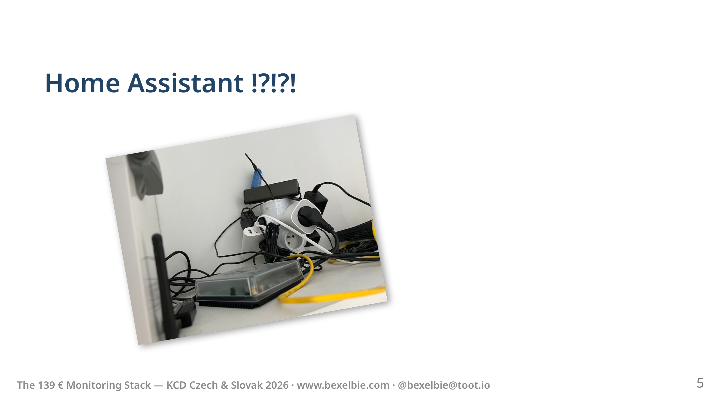
Notes:
- My monitoring stack is Home Assistant on a Home Assistant Green.
- It costs 139 euros. It lives in my data center.

Slide 6
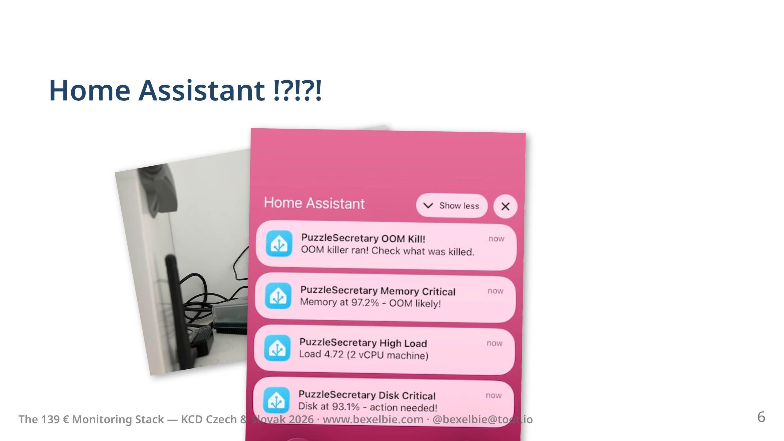
Notes:
- My monitoring stack is Home Assistant on a Home Assistant Green.
- It costs 139 euros. It lives in my data center.
- Like PagerDuty, it can blow up your phone.

Slide 7
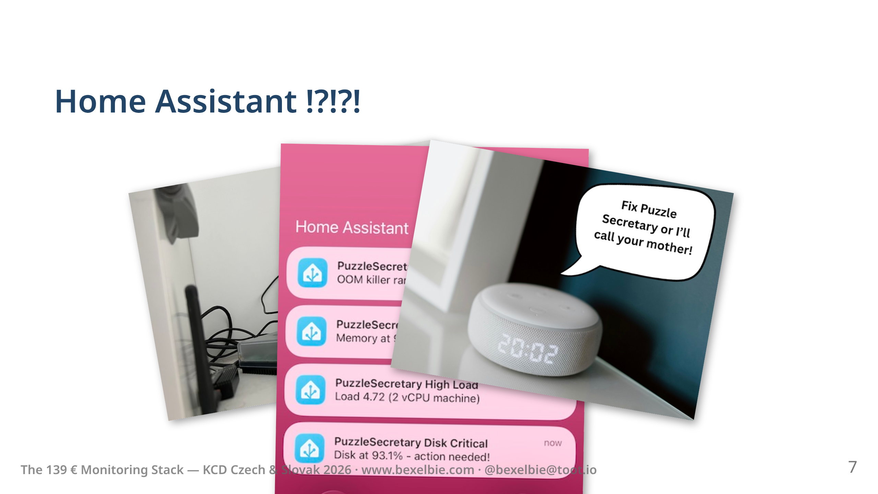
Notes:
- My monitoring stack is Home Assistant on a Home Assistant Green.
- It costs 139 euros. It lives in my data center.
- Like PagerDuty, it can blow up your phone.
- Unlike PagerDuty, home assistant can haunt you

Slide 8
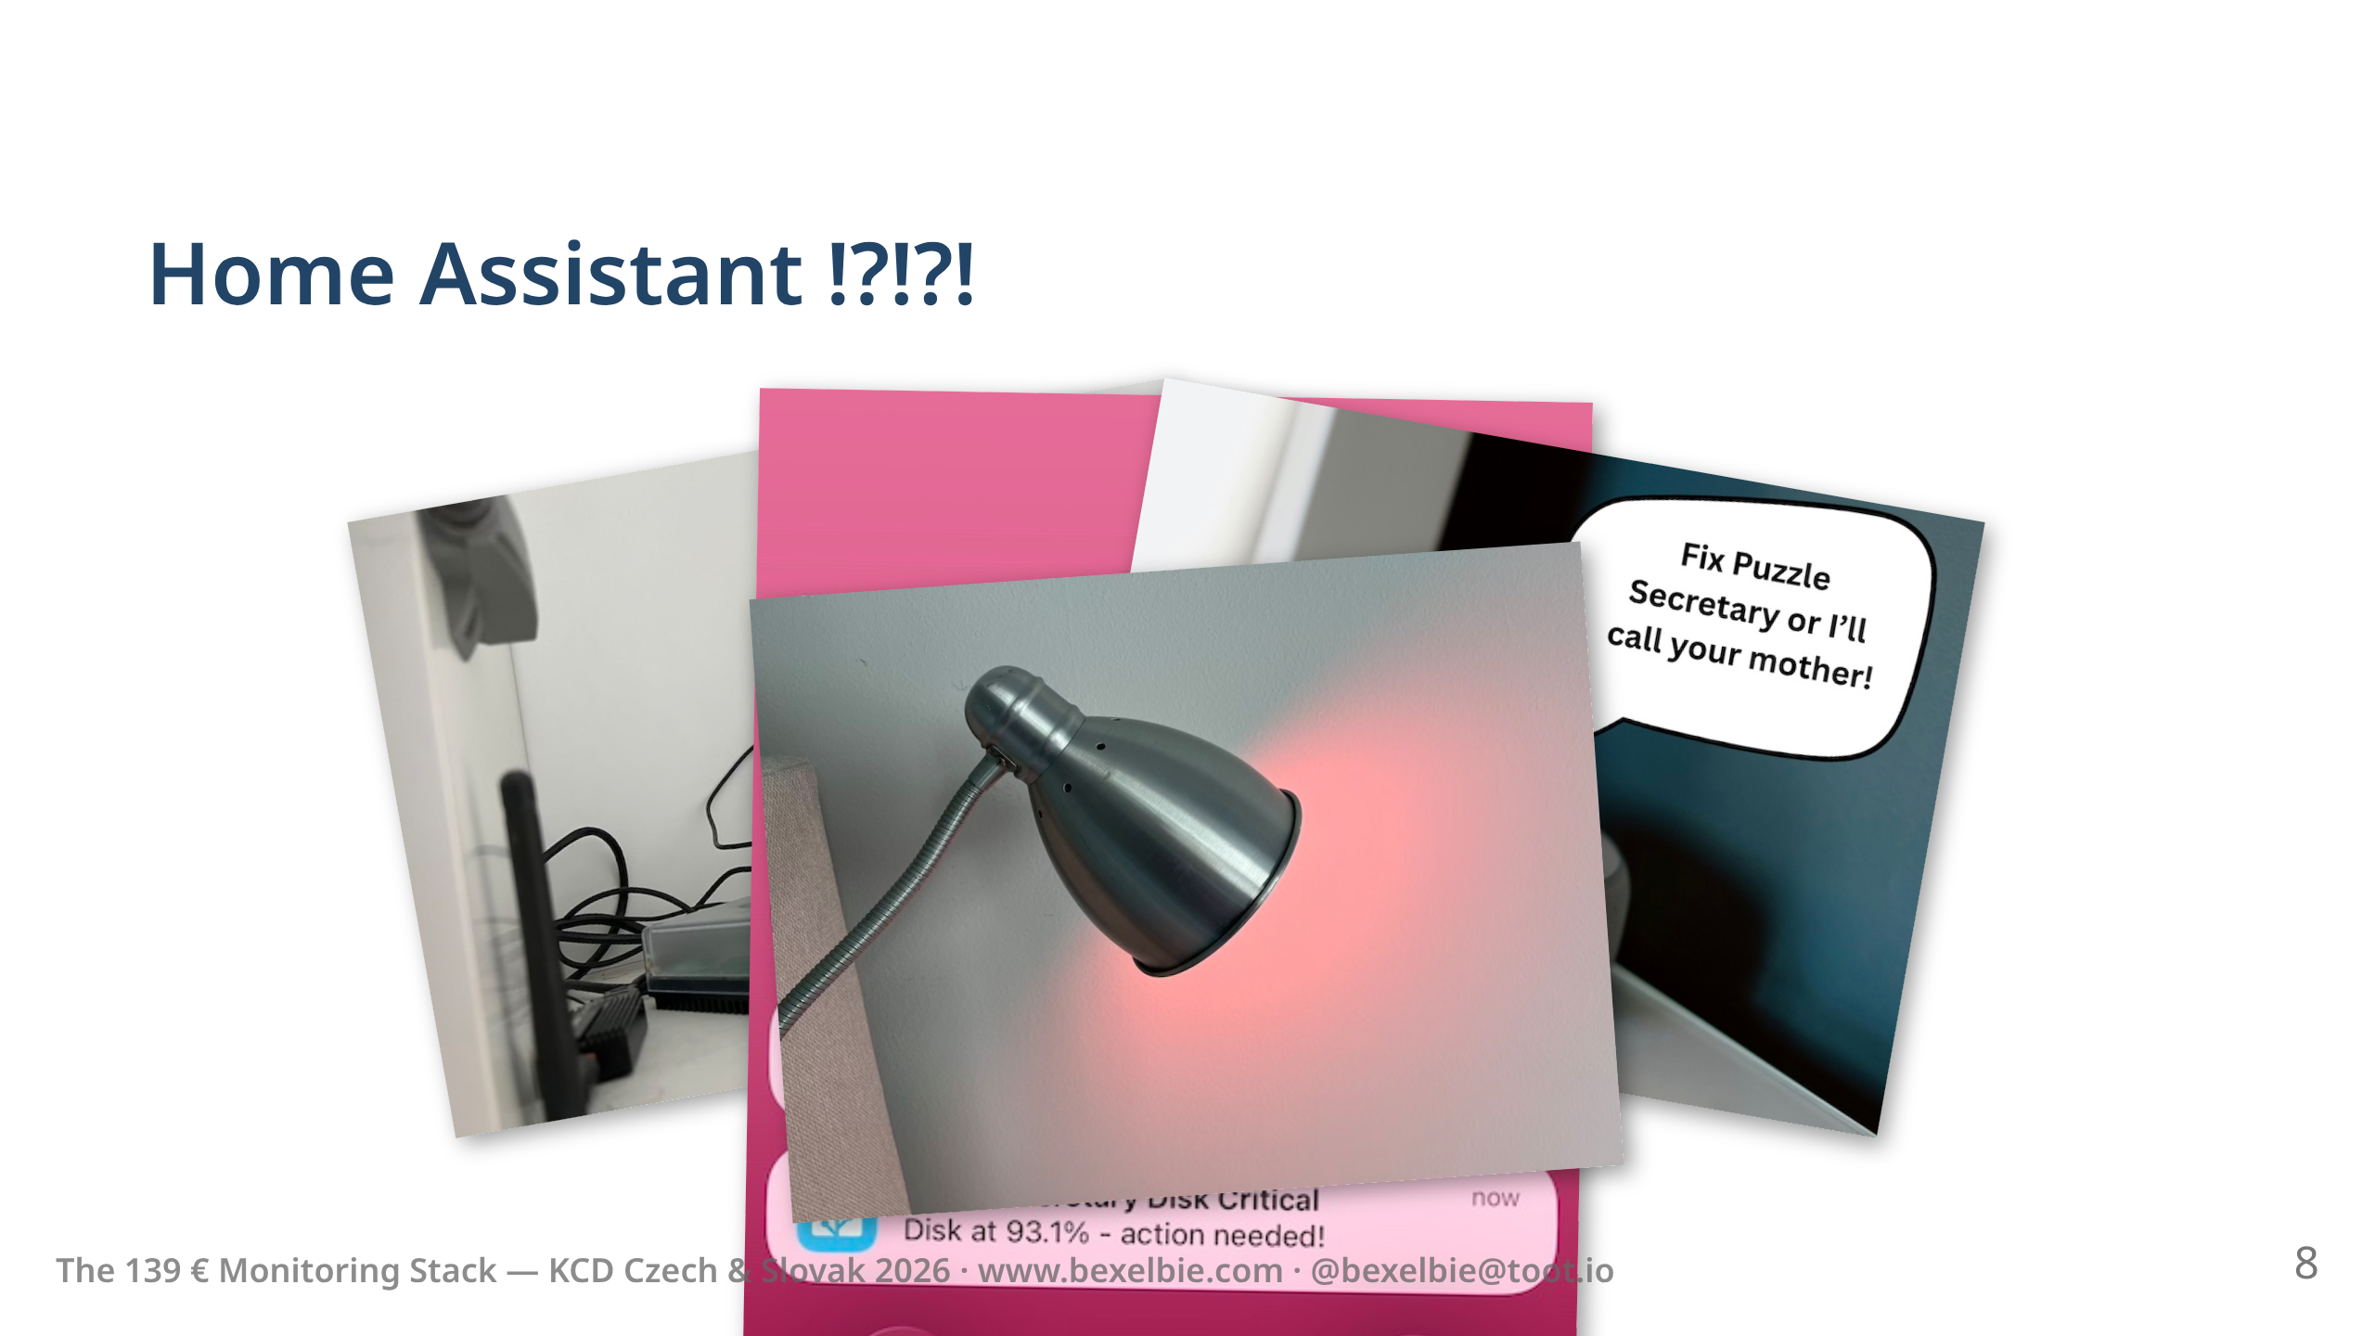
Notes:
- My monitoring stack is Home Assistant on a Home Assistant Green.
- It costs 139 euros. It lives in my data center.
- Like PagerDuty, it can blow up your phone.
- Unlike PagerDuty, home assistant can haunt you
- Nothing says SEV-1 like your hallway being disappointed in you.

Slide 9
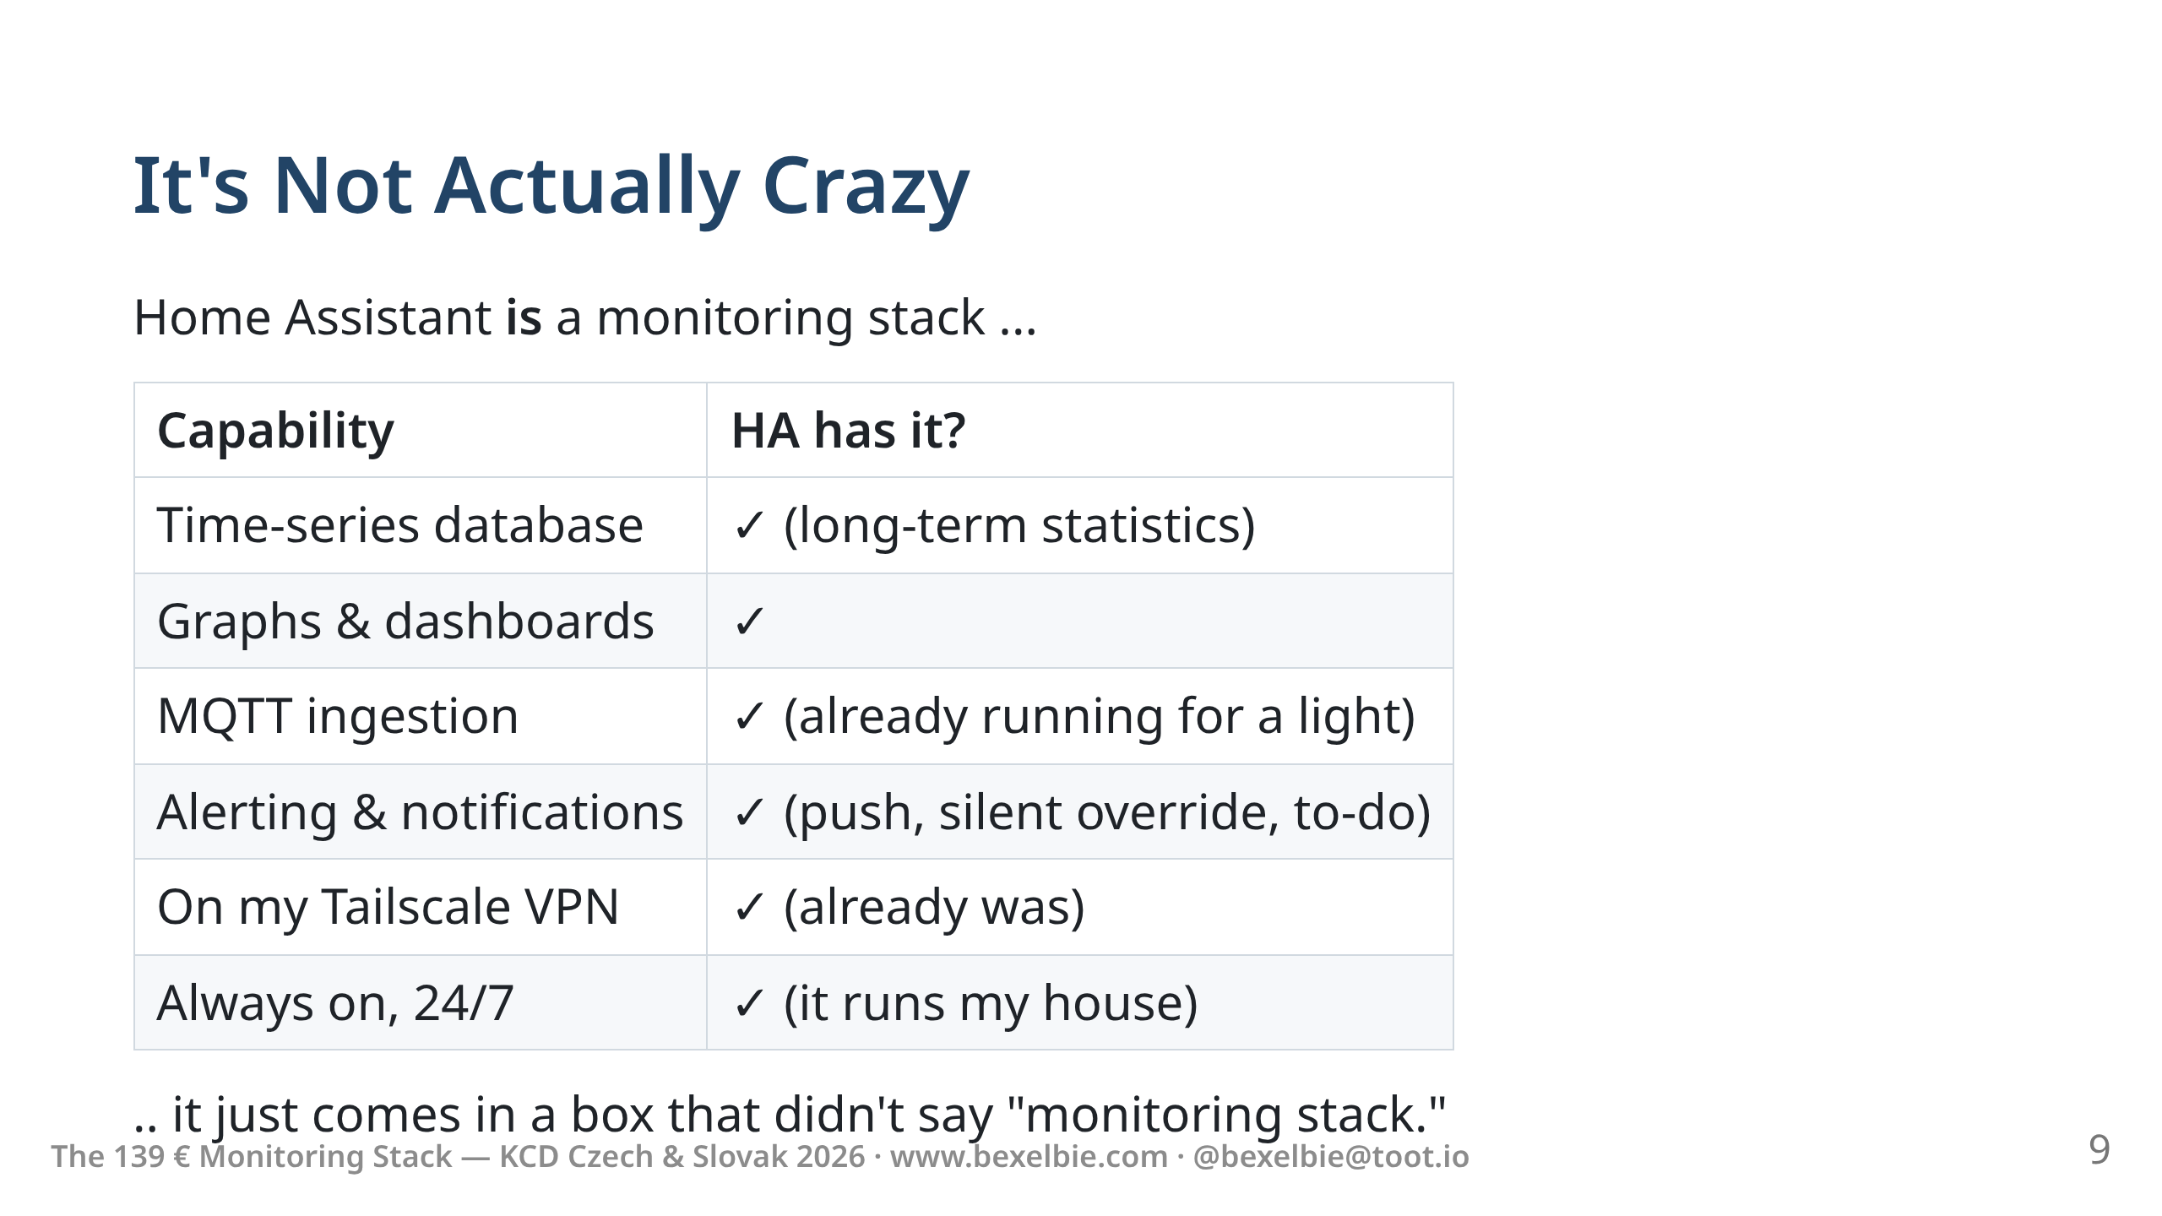
Notes:
- Here's why this isn't as ridiculous as it sounds.
- HA already stored time-series data: batteries, temperatures, water meter readings.
- What is CPU load but a temperature sensor for nerds?
- It already ran MQTT because one of my lights needs it.
- It was already on Tailscale because I wanted remote access.
- It was already always-on because it if it isn't I have to turn on the lights with a switch ... like an animal.
- I didn't install a monitoring stack. I noticed I already had one.

Slide 10
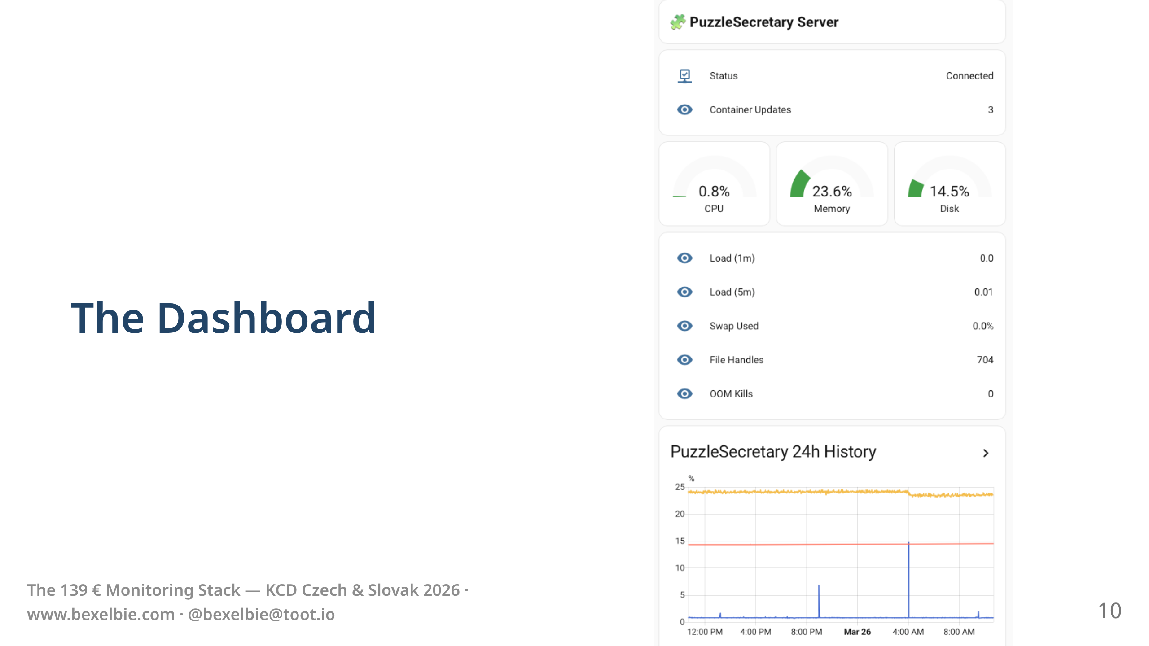
Notes:
- There is a dashboard that I don't look at
- But when something breaks, the history is there.
- I can see the curve that led to the problem.

Slide 11
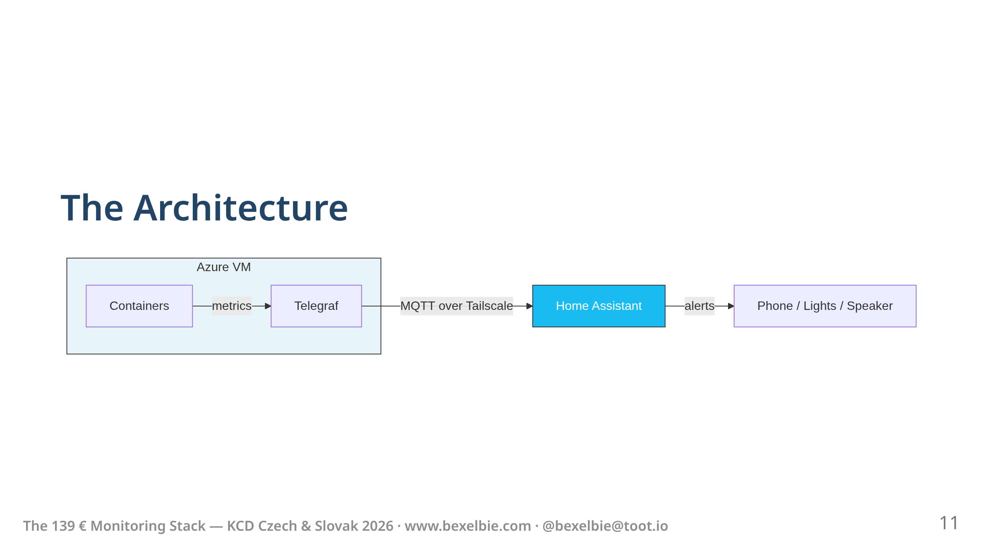
Notes:
- Telegraf runs as a container on the VM. Gathers stats about both the server and the game system itself.
- Publishes MQTT messages over Tailscale to Home Assistant.
- Home assistant makes decisions about alerts and tracks stats
- That's it. That's the whole thing.

Slide 12
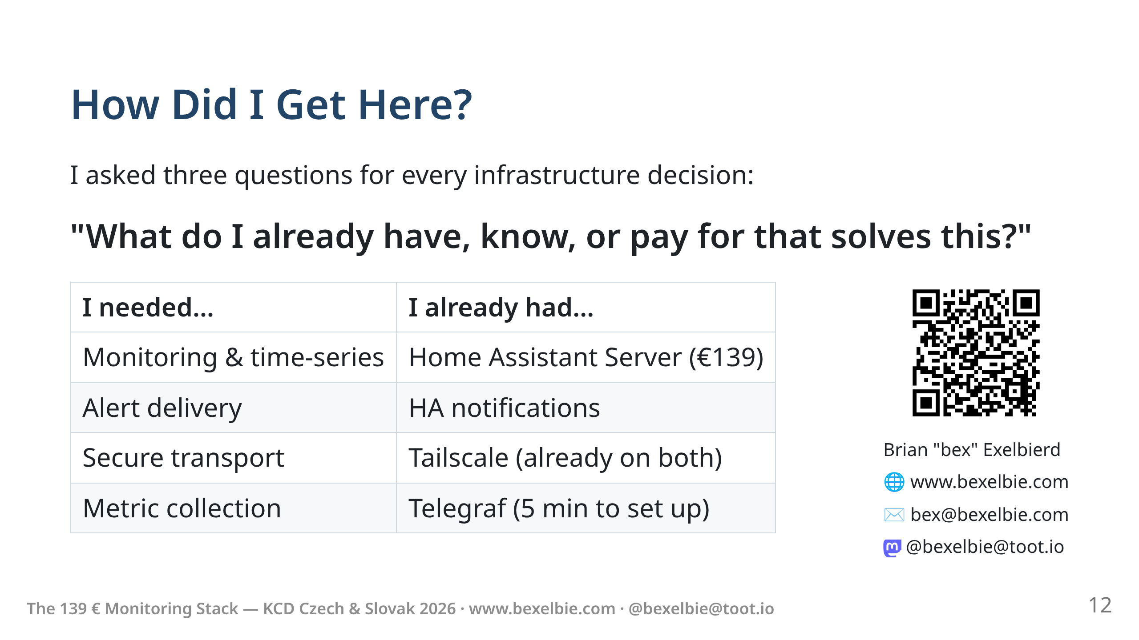
Notes:
- The take away is this
- I didn't set out to build something weird.
- I asked: what do I already have, already know, and already pay for? And then I looked to see if those things would just solve my problem.
- This lets me stay focused on the fun part — adding games, improving UX. Delivering my product.
- Monitoring: Home Assistant. Transport: Tailscale. Collection: Telegraf from InfluxDB
- The point isn't "use Home Assistant."
- Before you build a platform for your platform, ask what you already have, know or pay for.
- Thank you. I'm bex. The slides are at the QR code.

Slide 13

Notes:
Mermaid rendering: use `marp --html` to enable

